Slide 1
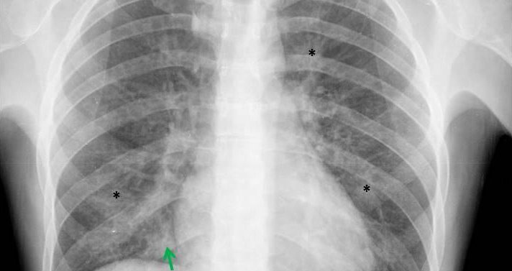
MODELING FOR SCREENING OF
HEART DISEASE PATIENTS
FROM LUNG X-RAY USING MACHINE LEARNING
FINAL Project
Management Information System

Slide 2
OUR TEAM
JATUWAT
JATURAGOMOL
6010551854
SUPHANAT BOONBUNDRANSUK
6010552273
PONGSAKORN
SAKULPRUEK
6010552117

Slide 3


PAPIS WONGCHAISUWAT

Slide 4
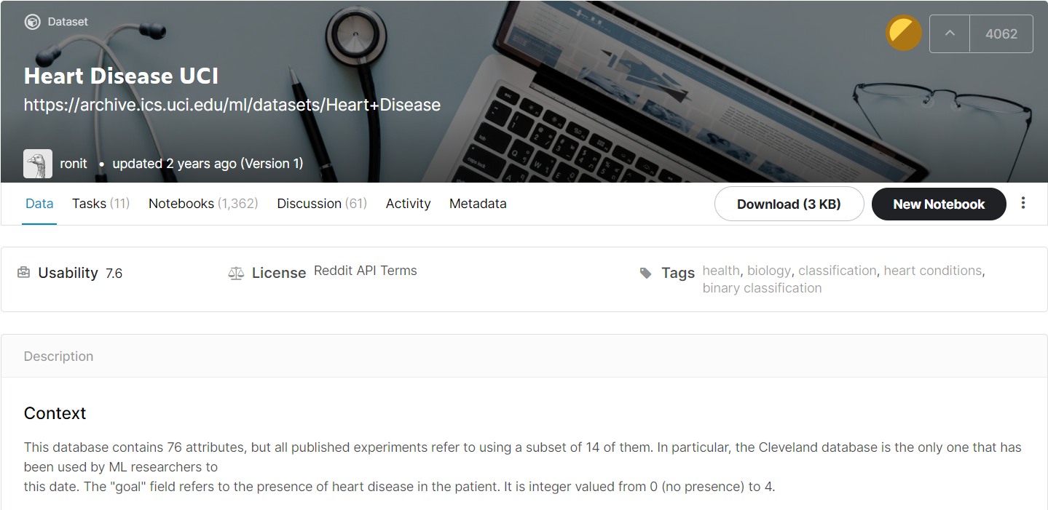

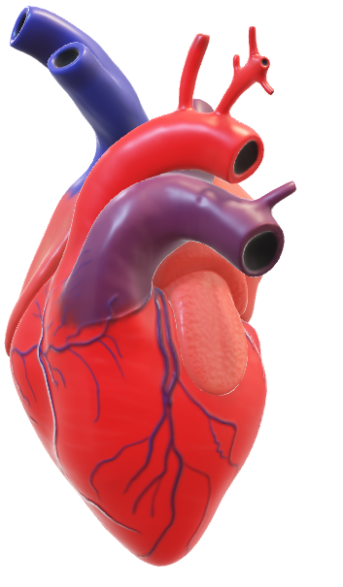
DATA
ข้อมูลจาก
WWW.KAGGLE.COM

Slide 5
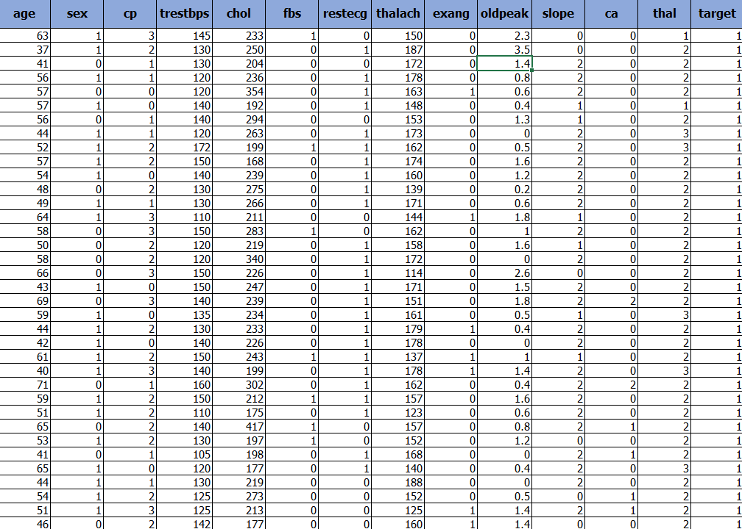
DATA TABLEAU
14 Columns
303 Rows

Slide 6
FEATURES
AGE
SEX
CP (CHEST PAIN TYPE)
TREST BPS
CHOLESTORAL
FBS (FASTING BLOOD SUGAR & GT)
REST ECG (RESTING ELECTROCARDIOGRAPHIC)
THALACH (MAXIMUM HEART RATE)
EXANG (EXERCISE INDUCED ANGINA)
OLD PEAK (ST depression induced by exercise relative to rest)

Slide 7

LABEL
TARGET (HEART DISEASE)
……………………….
0 >>> NO FINDING
1 >>> FINDING

Slide 8
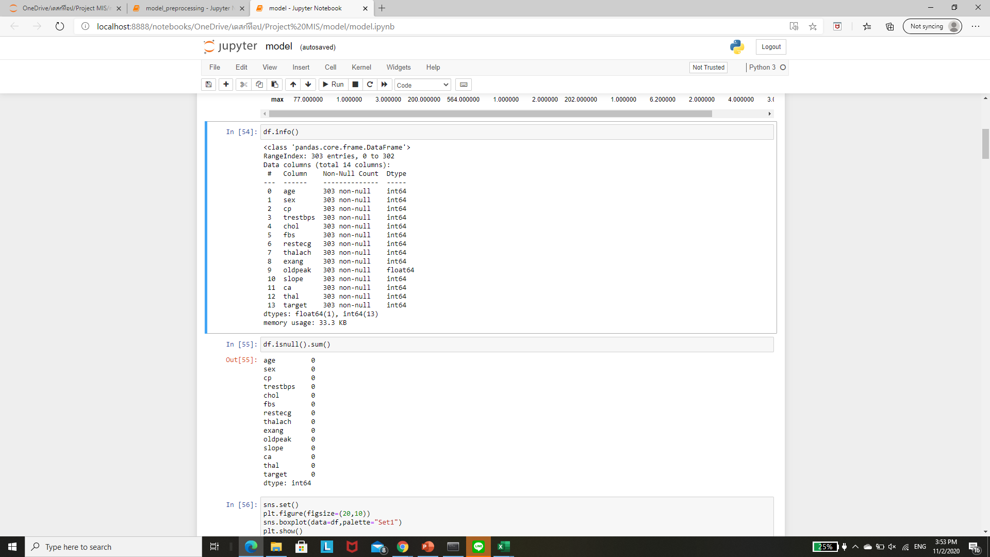
RAW DATA

Slide 9
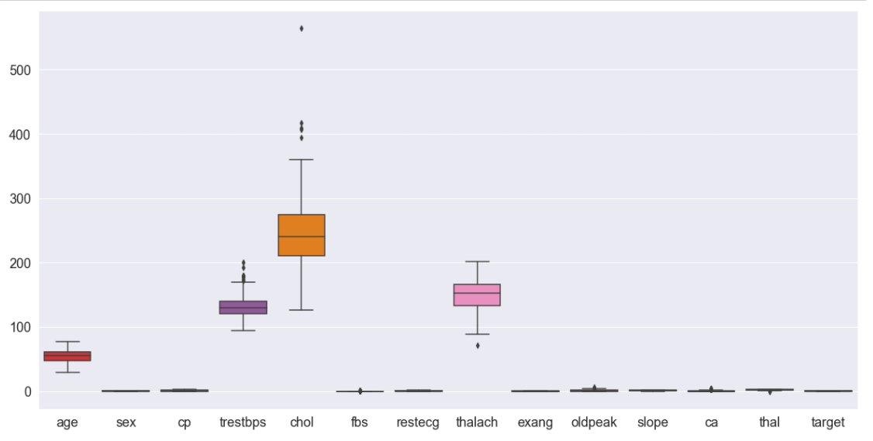
PREPROCESSING
Block plot

Slide 10
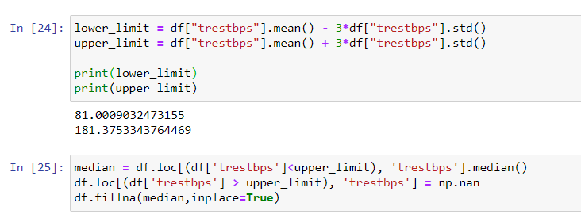
PREPROCESSING
Outlier Detection

Slide 11
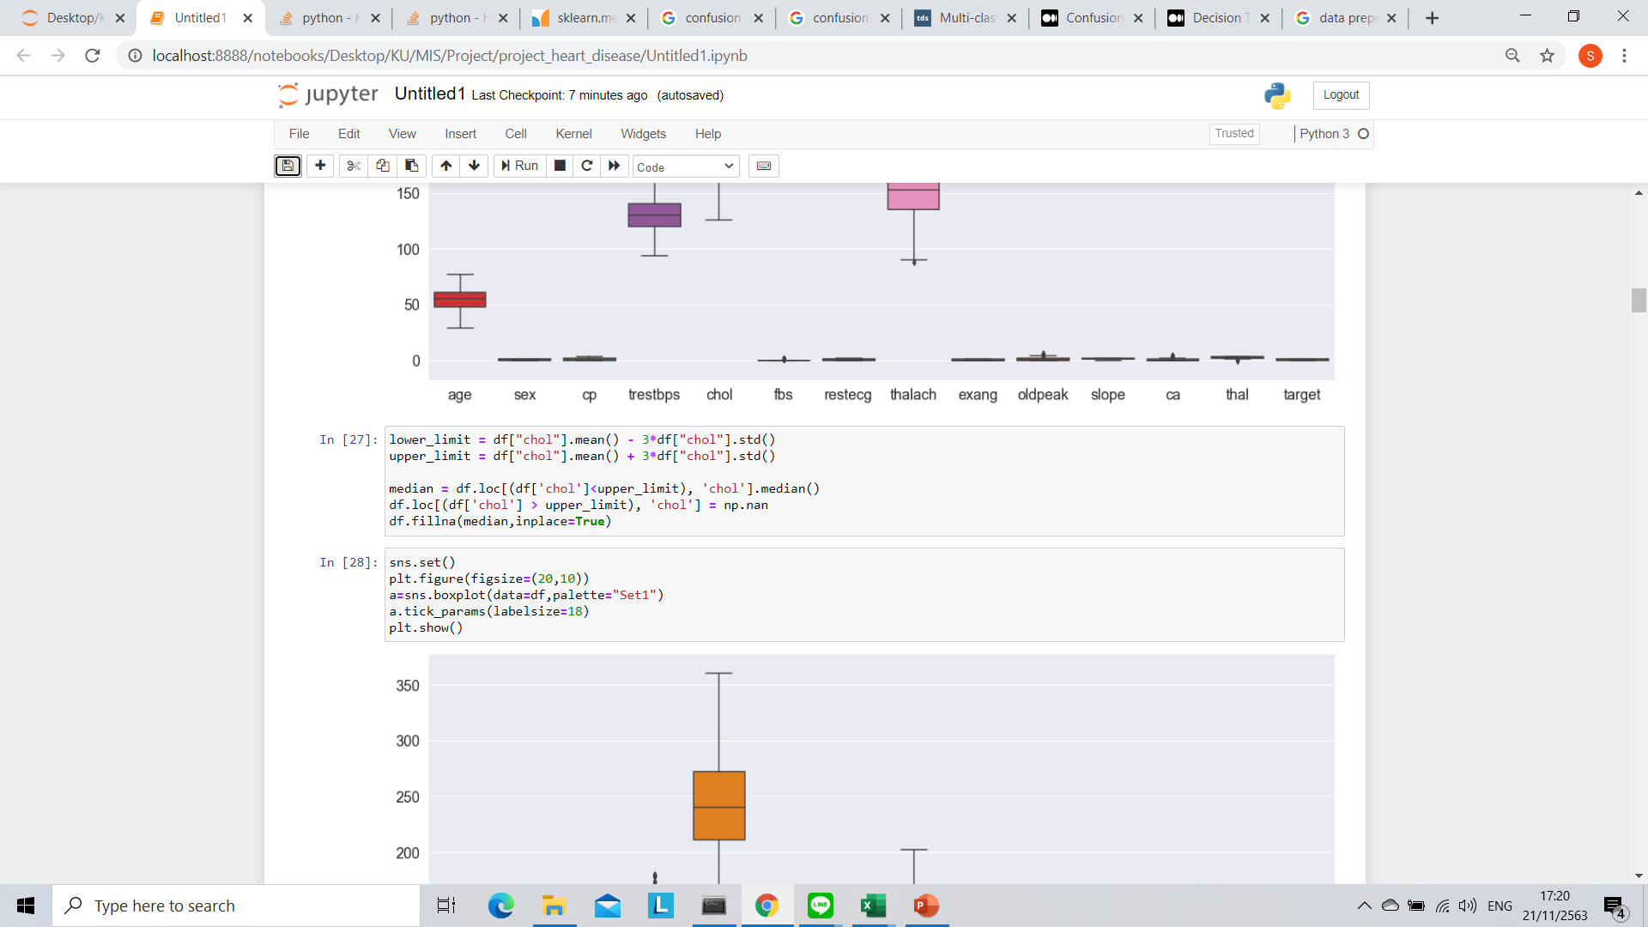
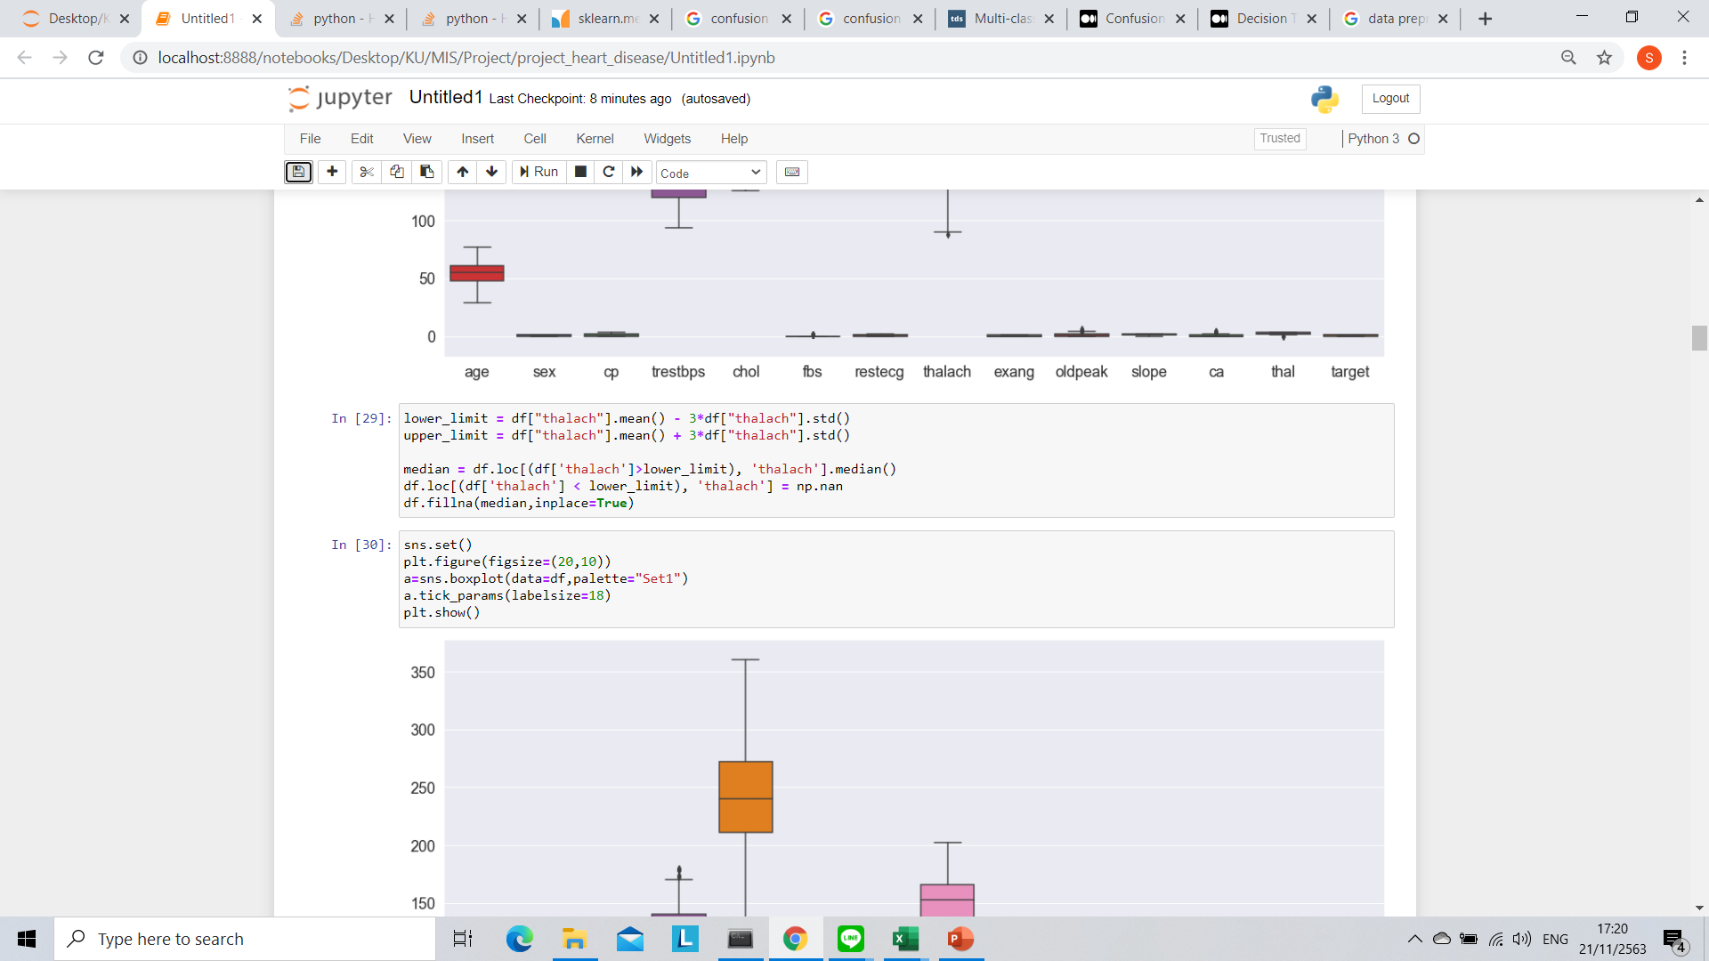
PREPROCESSING
Outlier Detection

Slide 12
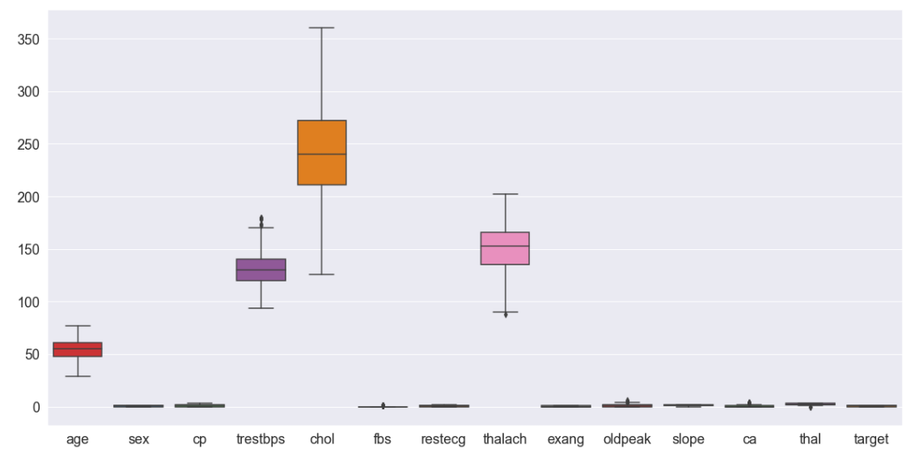
PREPROCESSING
Block plot

Slide 13
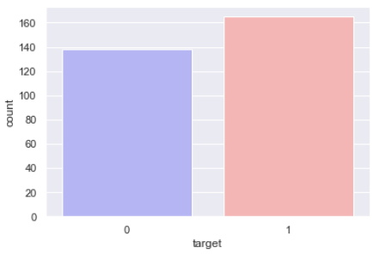
สรุปผล
Block plot
OUTLIER >>> MEAN
0 >>> NO FINDING >>> 138
1 >>> FINDING >>> 165

Slide 14
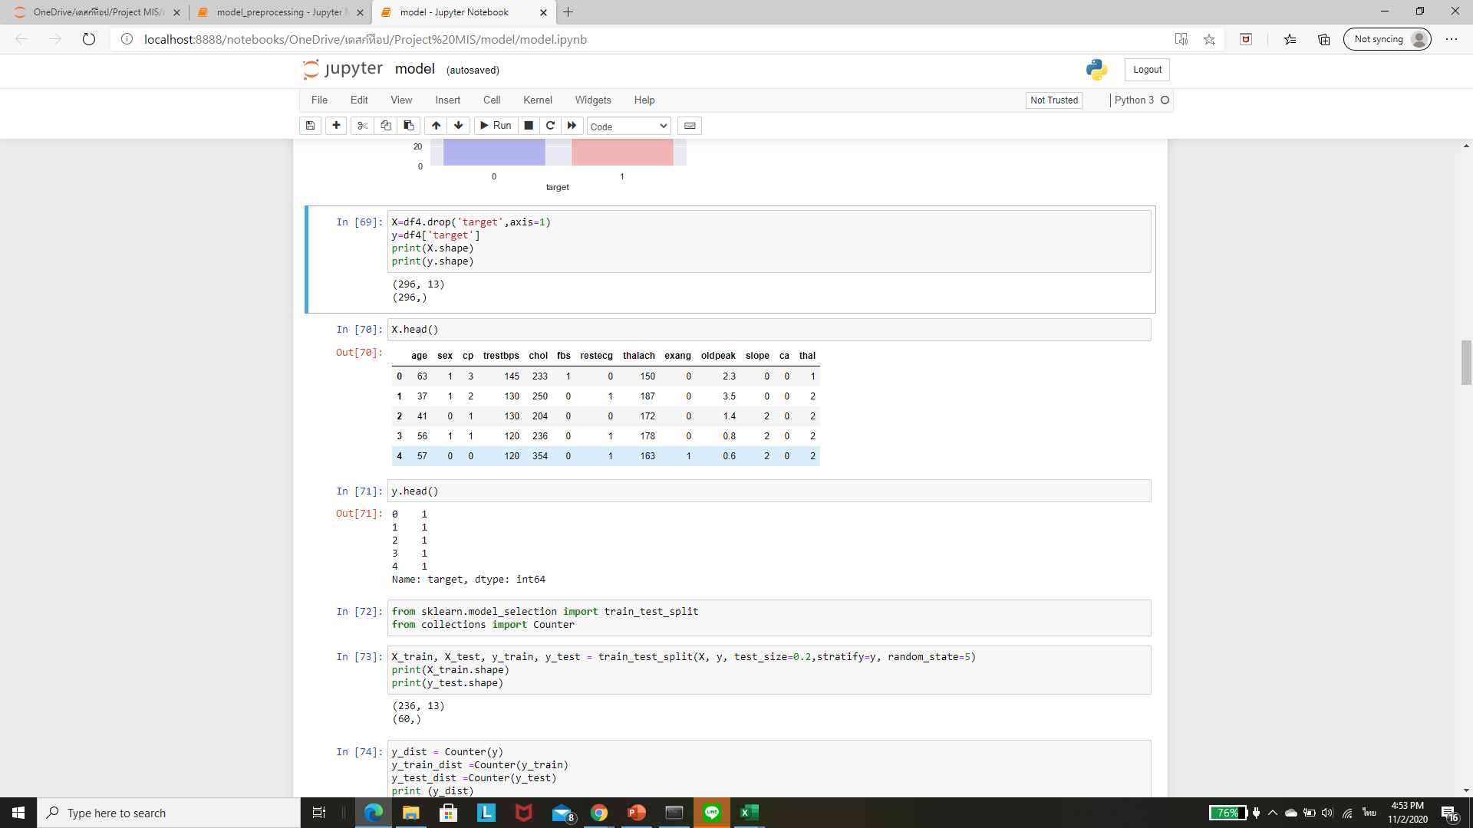
PROCESSED DATA
FEATURES
LABEL

Slide 15
TRAIN TEST SPLIT
แบ่ง TRAIN >>> 80%
- NO FINDING 110 ข้อมูล จาก 138 ข้อมูล
- FINDING 132 ข้อมูล จาก 165 ข้อมูล
แบ่ง TEST >>> 20%
- NO FINDING 28 ข้อมูล จาก 138 ข้อมูล
- FINDING 33 ข้อมูล จาก 165 ข้อมูล

Slide 16
MODEL SELECTION
DECISION TREE
criterion : entropy , gini
max_depth : 5 , 8 , 9
LOGISTIC REGRESSION
C : 1 , 5 , 10
RANDOM FOREST
n_estimators : 1 , 5 , 10
max_depth : 5 , 8 , 9
KNEIGHBOR
n_neighbors : 1,2,3,4,5,6,7,8,9,10
NAÏVE BAYES
ENSEMBLE

Slide 17
GRIDSERCH CV
DECISION TREE
criterion : entropy
max_depth : 9
LOGISTIC REGRESSION
C : 1
RANDOM FOREST
n_estimators : 10
max_depth : 5
K-NEIGHBOR
n_neighbors : 6
NAÏVE BAYES
ENSEMBLE

Slide 18
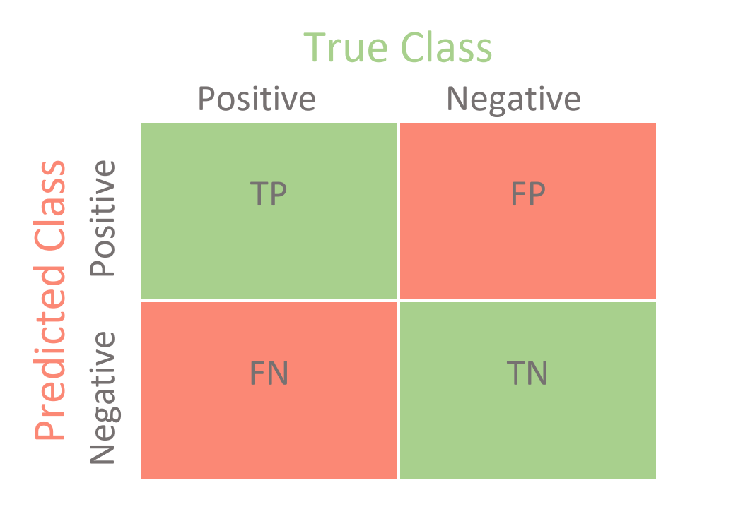
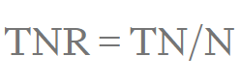
Evaluate MODEL
FOCUS FINDING(1)
Confusion Matrix
>>> Specificity(True Negative Rate)

Slide 19
Evaluate MODEL
DECISION TREE
Specificity(TNR) >>> 0.6562
LOGISTIC REGRESSION
Specificity(TNR) >>> 0.8571
RANDOM FOREST
Specificity(TNR) >>> 0.8181
KNEIGHBOR
Specificity(TNR) >>> 0.7647
NAÏVE BAYES
Specificity(TNR) >>> 0.6071
ENSEMBLE
Specificity(TNR) >>> 0.7878

Slide 20
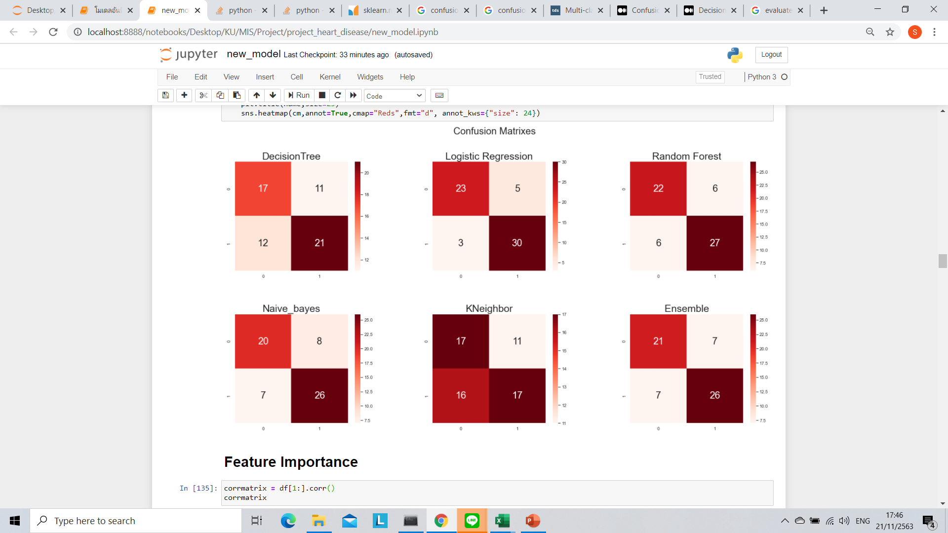
CONFUSION MATRIXES

Slide 21
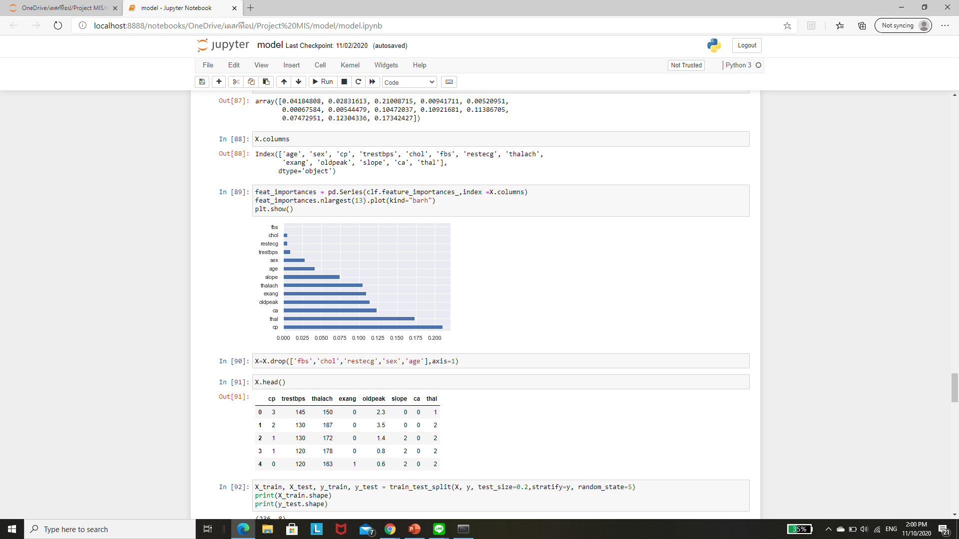
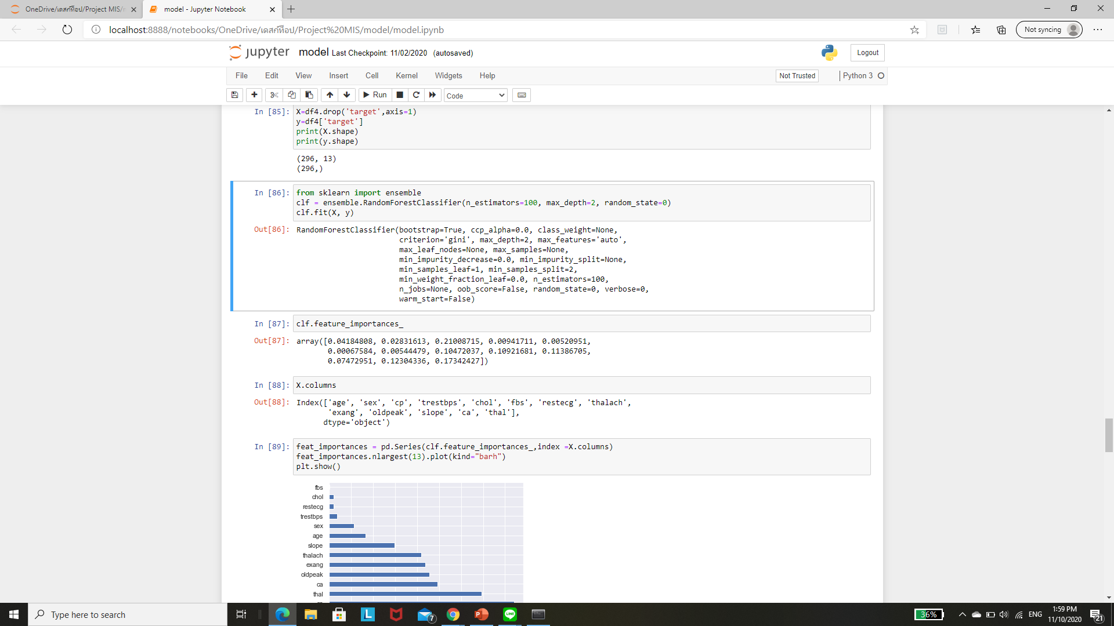
FEATURES SELECTION

Slide 22
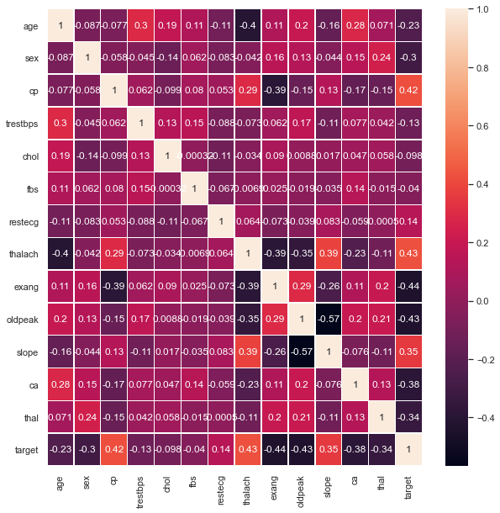
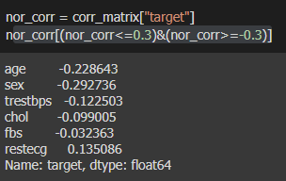
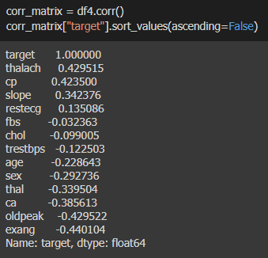
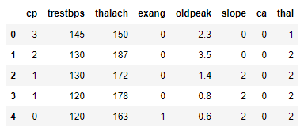
FEATURES
SELECTION

Slide 23
GRIDSERCH CV หลังตัด FEATURES
DECISION TREE
criterion : entropy
max_depth : 8
LOGISTIC REGRESSION
C : 1
RANDOM FOREST
n_estimators : 10
max_depth : 8
KNEIGHBOR
n_neighbors : 7
NAÏVE BAYES
ENSEMBLE

Slide 24
หลังตัด FEATURES
DECISION TREE
Specificity(TNR) >>> 0.6571
LOGISTIC REGRESSION
Specificity(TNR) >>> 0.7941
RANDOM FOREST
Specificity(TNR) >>> 0.7647
KNEIGHBOR
Specificity(TNR) >>> 0.7812
NAÏVE BAYES
Specificity(TNR) >>> 0.7250
ENSEMBLE
Specificity(TNR) >>> 0.7714

Slide 25
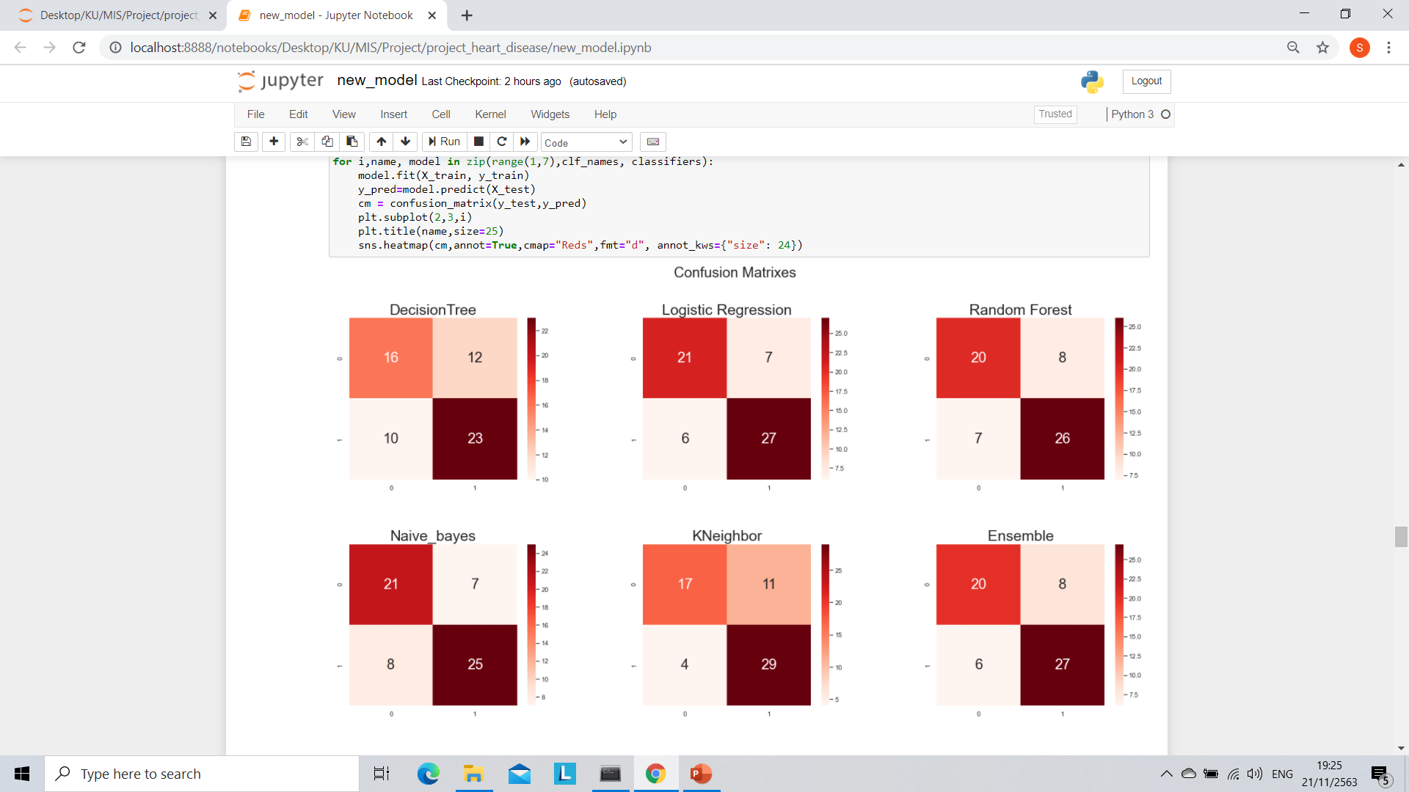
CONFUSION MATRIXES

Slide 26
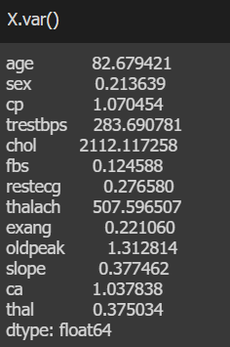
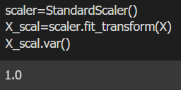
Standard Scaler
Using Standard Scaler

Slide 27
Standard Scaler
GRIDSERCH CV
DECISION TREE
criterion : gini
max_depth : 9
LOGISTIC REGRESSION
C : 5
RANDOM FOREST
n_estimators : 5
max_depth : 8
KNEIGHBOR
n_neighbors : 2
NAÏVE BAYES
ENSEMBLE

Slide 28
Standard Scaler
GRIDSERCH CV
DECISION TREE
Specificity(TNR) >>> 0.7027
LOGISTIC REGRESSION
Specificity(TNR) >>> 0.8484
RANDOM FOREST
Specificity(TNR) >>> 0.7419
KNEIGHBOR
Specificity(TNR) >>> 0.7647
NAÏVE BAYES
Specificity(TNR) >>> 0.7407
ENSEMBLE
Specificity(TNR) >>> 0.8125

Slide 29
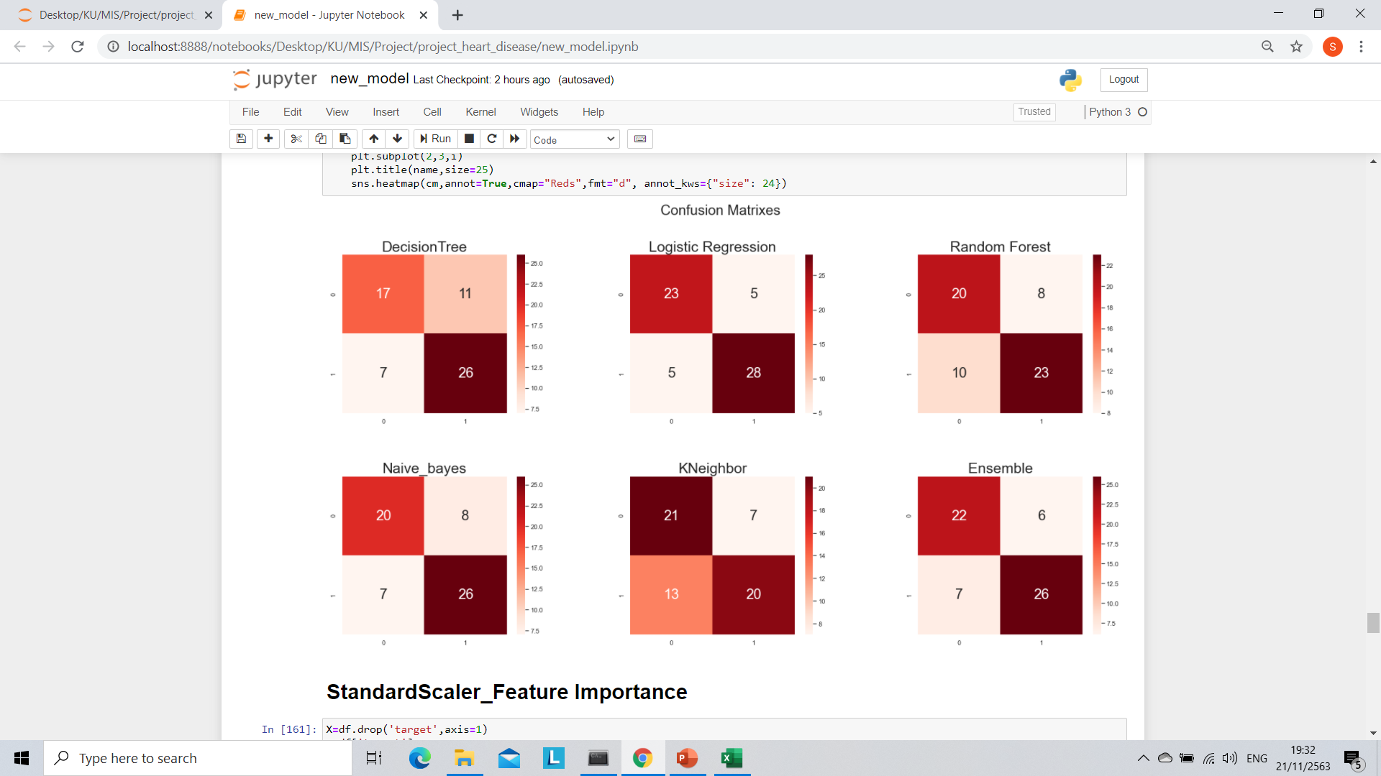
CONFUSION MATRIXES

Slide 30
Standard Scaler
หลังตัด FEATURES
DECISION TREE
criterion : gini
max_depth : 5
LOGISTIC REGRESSION
C : 1
RANDOM FOREST
n_estimators : 5
max_depth : 5
KNEIGHBOR
n_neighbors : 2
NAÏVE BAYES
ENSEMBLE

Slide 31
Standard Scaler
หลังตัด FEATURES
DECISION TREE
Specificity(TNR) >>> 0.7073
LOGISTIC REGRESSION
Specificity(TNR) >>> 0.7941
RANDOM FOREST
Specificity(TNR) >>> 0.7777
KNEIGHBOR
Specificity(TNR) >>> 0.7812
NAÏVE BAYES
Specificity(TNR) >>> 0.8076
ENSEMBLE
Specificity(TNR) >>> 0.7941

Slide 32
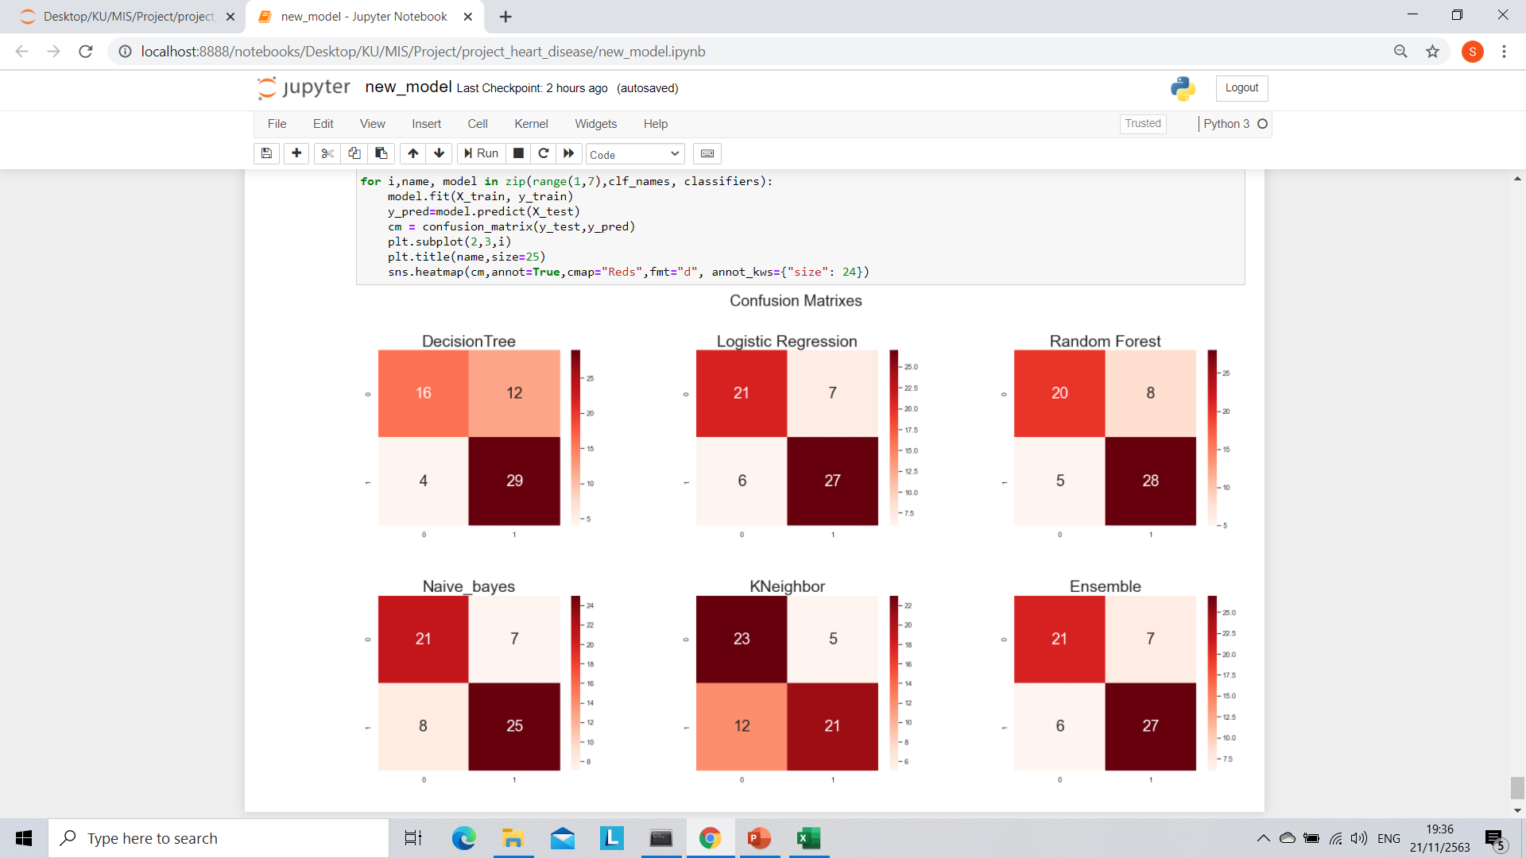
CONFUSION MATRIXES

Slide 33
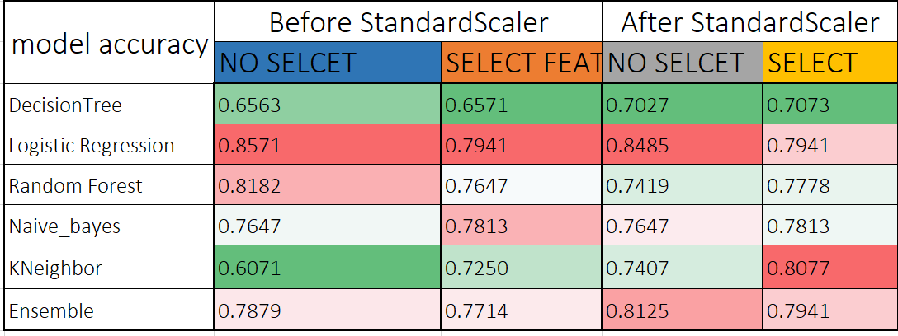
SUMMARY
Hight
Low

Slide 34
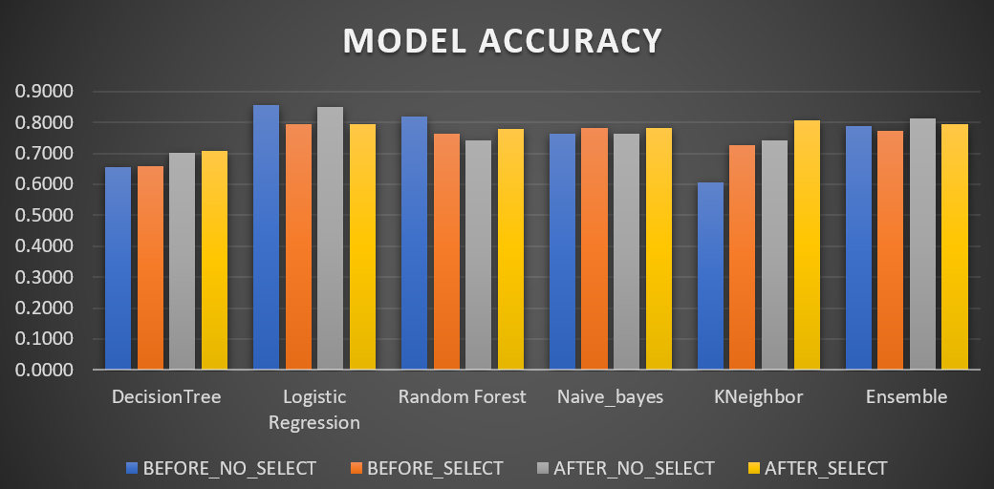
SUMMARY

